Slide 1


LLMs and Cyber Security
Adapting Cyber Defense to the Advance of AI
© 2025 Athena Software Group Inc. Confidential & Proprietary. Do not distribute without express permission.
By Peter J Worth Jr
President & CEO, Athena Software Group

Slide 2

01
Mission Statement
02
Market Opportunity
ASG Overview
03
Who we are and what we do
04
Products & Services
05
Leadership Team
06
Financial Model

Slide 3
Athena Software Group Inc.
A company founded under the principles of integrating Cyber Security best practices, high end custom enterprise software and artificial intelligence (LLMs).
Athena Software Group brings together some of the best minds in computer science, cyber defense and SaaS to design solutions specifically for application service providers.
We take a fully integrated and analytical approach to Cyber Security defense, knowing through experience that the best Cyber Defense strategies arise from providing the best analysts with the best tools from within a fully integrated cyber security infrastructure that is informed by the latest cyber and t
We intend to set a new bar in Cyber defense by providing tools along the entire Cyber defense stack which are fully integrated with Cyber specific trained LLMs that both understand the global threat landscape AND are informed by the technical specifications which underpin the application specific infrastructure environment facilitating higher quality, more rapid and informed outcomes with respect to threat and anomaly detection, response management, vulnerability management and compliance.

Slide 4
LLM Foundational Use Cases for Cyber Security
1. Threat Detection and Anomaly Identification
LLMs can analyze extensive logs, network events, and telemetry data, recognizing subtle patterns indicative of cyber threats or anomalies. They provide contextual understanding of suspicious activity, correlating seemingly unrelated events to identify potential breaches or attacks.
2. Security Incident Response Automation
Automating responses to standard security incidents by interpreting alerts, analyzing context, and suggesting or executing initial remediation steps. Streamlining the triage process to quickly prioritize critical threats based on context derived from past incidents.
3. Vulnerability Assessment and Management
Parsing security bulletins, advisories, and CVE databases to summarize and highlight critical vulnerabilities relevant to an organization's infrastructure. Generating actionable mitigation strategies and prioritization recommendations tailored to the organization's specific technologies and risk profile.
4. Phishing and Social Engineering Detection
Identifying suspicious patterns in emails, text messages, and other communication platforms by leveraging natural language understanding to detect phishing, impersonation, or manipulative techniques. Educating users by generating realistic phishing simulations or context-aware cybersecurity training content.
5. Cybersecurity Documentation and Compliance Automation
Generating compliance reports, incident documentation, and audit logs automatically, reducing the manual burden associated with regulatory requirements (e.g., GDPR, NYSDFS 23 NYCRR 500).Assisting in the interpretation of regulatory texts, summarizing complex cybersecurity requirements, and suggesting compliance actions.
6. Intelligent Threat Intelligence
Parsing vast amounts of threat intelligence data to provide concise, actionable insights tailored to an organization's unique threat landscape. Automatically generating intelligence reports or briefings about emerging threats and their implications for the organization.
7. Cybersecurity Assistant (Chatbot/Virtual Analyst)
Serving as a first-line assistant that provides cybersecurity support, answering questions about policies, procedures, recent threats, or incident response guidelines. Assisting cybersecurity analysts by summarizing logs, incidents, or threat intelligence data to expedite informed decision-making.
8. Code and Software Security Analysis
Reviewing code repositories, documentation, and logs to identify potential security weaknesses, such as insecure coding patterns, hardcoded credentials, or risky configuration settings. Suggesting secure coding practices and generating contextual remediation steps.
9. Enhanced SIEM and Log Analysis
Integrating LLMs with Security Information and Event Management (SIEM) platforms to provide enhanced semantic understanding of security logs, correlate events, and reduce false positives through natural language analysis. Improving root-cause analysis by interpreting event logs and contextualizing security events.
10. Retrieval-Augmented Generation (RAG) for Security
Employing RAG models to access up-to-date cybersecurity knowledge bases or internal documentation, providing timely, accurate, and contextually relevant answers during security incidents or routine operations.
Threat intelligence application is the target for first phase, with incident response, compliance automation, analysts support and RAG integration (1, 2, 5, 7 and 10) as potential targets thereafter. Models must be trained on Cyber security data (public + private) and then plugged into the environment for proper contextualization and customization of output

Slide 5
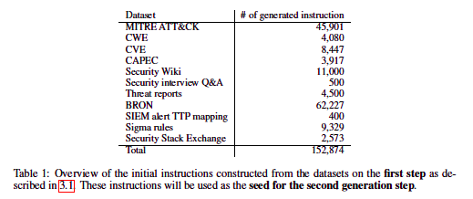
CyberPal.AI (IBM)
SecKnowledge is a domain-knowledge-driven cyber-security instruction dataset, meticulously designed using years of accumulated expert knowledge in the domain through a multi-phase generation process
Base Model: Open-source LLMs (specific base model not specified).​
Training Methodology:
  Instruction Tuning: Utilizes SecKnowledge dataset, created through a two-step process involving expert-defined schemas and hybrid synthetic content generation.​
  SecKnowledge: A domain-specific instruction dataset encompassing various cybersecurity topics.
  SecKnowledge-Eval: An evaluation suite designed to assess LLMs on complex cybersecurity tasks.​
Benchmark Performance:
  Training-Aligned Tasks: Up to 24% improvement over baseline models.
  Public Cybersecurity Benchmarks: Up to 10% improvement.
  Specific Task Improvements:
    CTI Detection and Mitigation: Up to 26% improvement.
    SIEM Rule TTP Mapping: Up to 17% improvement.
    CWE Summarization: Up to 35% improvement.
    CWE Technical Impact Mapping: Up to 11% improvement.
Levi, Matan et al. “CyberPal.AI: Empowering LLMs with Expert-Driven Cybersecurity Instructions.” ArXiv abs/2408.09304 (Aug. 2024): https://doi.org/10.48550/arXiv.2408.09304

Slide 6
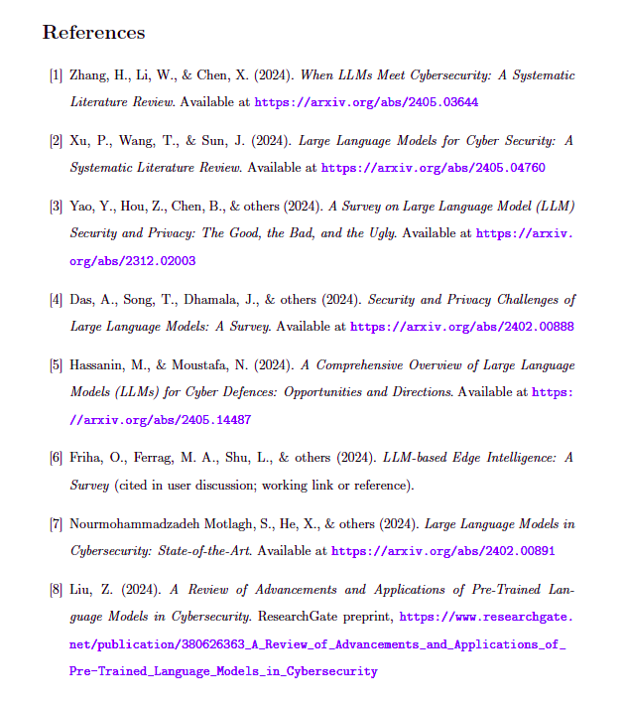
Survey Research Literature in Cyber Security

Slide 7

Athena Software Group
Best in Class, AI Enabled, security solutions for Enterprise application providers.

Slide 8


Glaukopis (γλαυκῶπις) the “grey eyed one”

